Slide 1
INFO 364 Fall 2016: Lecture Notes #2
ENTITY-RELATIONSHIP MODELING

Slide 2
ENTITY-RELATIONSHIP DATA MODEL (ERM)
Main components are:
Entities
Relationships
Attributes

Slide 3
E-R MODEL
An ENTITY is a distinct object (e.g. Customer, Product, Supplier, Competitor) about which an organization chooses to record data.
Its name is a NOUN.
It must have an Identifier that has the Uniqueness property
It must have Descriptive information, other than its Identifier
A RELATIONSHIP is an association between two or more ENTITIES about which the organization chooses to record data.
Its name is a VERB.
An ATTRIBUTE is a property or characteristic of an ENTITY or a RELATIONSHIP about which the organization chooses to record data.
Its name is a NOUN.

Slide 4
ERM Rules
Every Entity type, Relationship type, and Attribute type should be named.
Each ERD must include at least one Entity type.
Each Entity type may appear only once in an ERD.
Each ERD must include at least one Relationship type.

Slide 5
ERM Rules (cont’d)
Each Entity type must participate in at least one Relationship type.
Each Attribute must be connected to an Entity type or a Relationship type.
Each Relationship type must be connected to either at least 2 Entity types (binary or ternary) or to one Entity type twice (unary).

Slide 6
E-R Diagram (ERD)
E-R Models (ERM) can be represented visually using E-R diagrams (ERD).
There are different conventions for drawing ERDs including:
Chen style
Crowfoot style

Slide 7
Chen & Crowfoot Conventions: Attributes of the Student Entity

Slide 8
ERD: Chen style
Original ERD convention
It utilizes:
Rectangles for Entity types
Ellipses for Attributes
Diamonds for Relationship types
Explicit representation of One-to-Many (1:M) relationship types
Explicit representation of Many-to-Many (M:M) relationship types, including those with associated Attributes
Lines to link Components
Each component is labeled with its corresponding name.
Foreign Keys (FK) are not explicitly represented

Slide 9
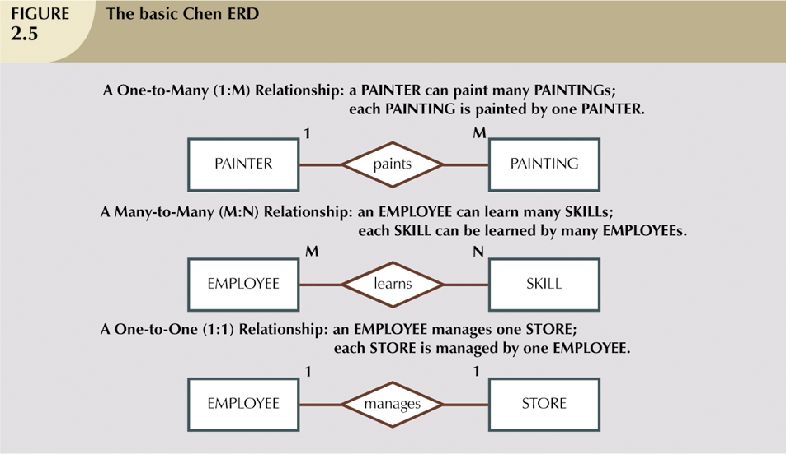
ERD – Chen style: Examples of Relationships

Slide 10
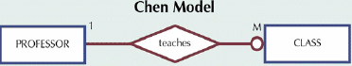
Relationship Participation
Optional:
One entity occurrence does not require a corresponding entity occurrence in a particular relationship
Shown by drawing a small circle on side of optional entity on ERD
Optional means that minimum cardinality is zero
Mandatory:
One entity occurrence requires a corresponding entity occurrence in a particular relationship
Shown by drawing a bar on side of mandatory entity on ERD
If no Optionality symbol is shown on ERD, it is Mandatory
Mandatory means that minimum cardinality is 1
In our example below, CLASS is Optional, PROFESSOR is Mandatory

Slide 11
Relationships: Connectivity & Cardinality
Established by Business Rules
Connectivity
Used to describe the Relationship Classification
1:1 (i.e. One-to-One)
1:M (i.e. One-to-Many)
M:N (i.e. Many-to-Many)
Cardinality
Expresses the specific number of Entity occurrences associated with one occurrence of the related entity

Slide 12
Relationships: Connectivity & Cardinality
Cardinality - Chen’s model:
Number is written beside the entity using (x, y) format
»x represents the minimum of entity occurrences (Min Card)
»y represents the maximum of entity occurrences (Max Card)
The DBMS can’t handle cardinality on table level
»“Triggers”(software code) must be written to handle cardinality

Slide 13
Relationships: Connectivity & Cardinality

Slide 14
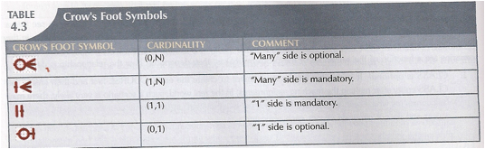
ERD: Crow Foot style
Rectangles for Entity types
Attributes included in rectangles for relevant entities
Relationships
One-to-Many (1:M) relationship type is represented by the inclusion of a Foreign Key (FK) in the rectangle for the entity on the “Many” side
Does not allow for direct Explicit representation of Many-to-Many (M:M) relationship types with associated non-identifier attributes
Each component is labeled with its corresponding name.

Slide 15
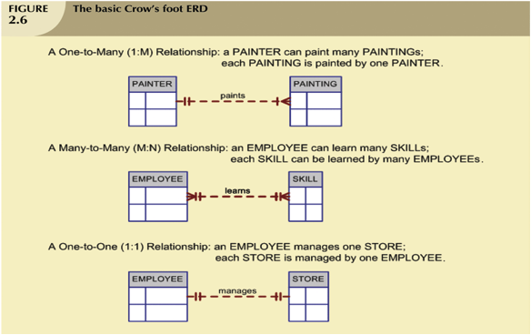
Crowfoot ERD: Examples of Relationships

Slide 16
Degree of Relationships

Slide 17
Recursive Relationship
Such Relationships involve occurrences of the same Entity Type

Slide 18
In-Class Exercise #1
Create the following Chen style & Crowfoot style of ERDs for the scenario below:
A Department employs many Employees; each Employee is employed by one Department. Some Employees, known as “rovers”, are not assigned to any Department.
A Division operates many Departments, but each Department is operated by one Division.
An Employee may be assigned to many Projects, and a Project may have many Employees assigned to it. Each Project must have at least one Employee assigned to it.
For each Project to which a given Employee Is assigned, the maximum number of hours (MAX_HRS) that he/she may work on the Project is specified.
Each Department is managed by a single Employee. A given Employee Is allowed to manage only one Department at a given point in time.
Each Division is run by a single Employee. A given Employee Is allowed to run only one Division at a given point in time.
Some Employees have never managed a Department nor run a Division.
 | IDENTIFIER | OTHER ATTRIBUTES
Department | DPID | DP_NAME, DP_LOCATION, DP_BUDGET
Division | DVID | DV_NAME, DV_LOCATION, DV_BUDGET
Employee | EMPID | E_FNAME, E_LNAME, E_DOB, E_JOB, E_SALARY
Project | PRID | P_NAME, P_DESCR, P_SDATE, P_LENGTH, P_BUDGET

Slide 19
M:M Relationship & Composite (i.e. Associative) Entity
M:M Relationship may also be represented as an Associative Entity (or Composite Entity)
Includes the Identifiers of each of the participating Entities in the M:M Relationship.
Also contains any attributes of the M:M Relationship

Slide 20
M:M Relationship & Composite (i.e. Associative) Entity

Slide 21
Relationship Strength
Existence Dependence (Weak/Dependent) Entity
Entity’s existence depends on the existence of one or more other entities
Example: Employee vs Dependent
Existence Independence Entity
Entity type can exist apart from one or more related Entity types
Often connected to other independent Entities in a 1:M or M:N Relationship

Slide 22
Weak ENTITY
Existence-dependent: cannot exist without (Owner) entity with which it has an Identifying relationship
Identification-dependent: Has primary key that is partially or totally derived from the Owner Entity in the relationship
Owner Entity set and Weak Entity set must participate in a one-to-many relationship set (one owner, many weak entities).
Weak Entity set must have total participation in this identifying relationship set.
Representation: In Chen’s model as a double-walled rectangle
Business Rules are used to determine if an Entity is weak
The Discriminator (or Partial Key) of a Weak Entity type is the set of attributes that distinguishes among all the entities of a weak entity type.
The Primary Key of a Weak Entity type is formed by the Primary Key of its Owner Entity type on which the Weak Entity type is existence dependent, plus the Weak Entity type’s Discriminator.

Slide 23
Weak ENTITY

Slide 24
Strong (Identifying) Relationship
One Entity (i.e. Weak) relies on another Entity (i.e. Parent) for its Existence & Identification
Identifier (PK) of Weak Entity is a Composite Key that includes the Identifier (PK) of its Parent (or Owner) Entity plus the Weak Entity type’s Discriminator (i.e. Partial Key)

Slide 25
Comparison of ER Modeling Symbols

Slide 26
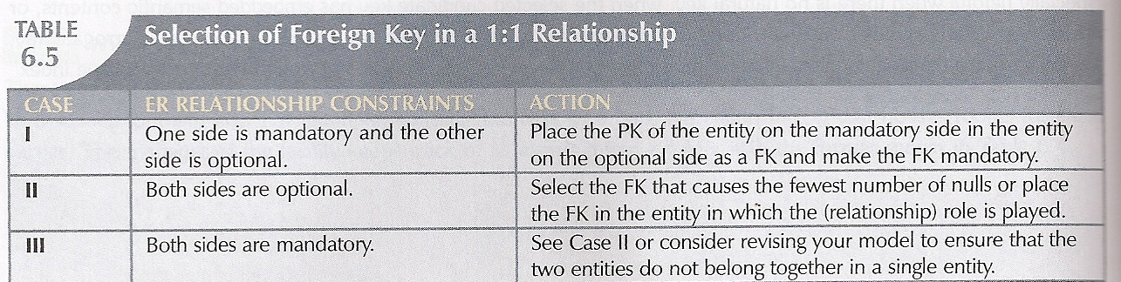
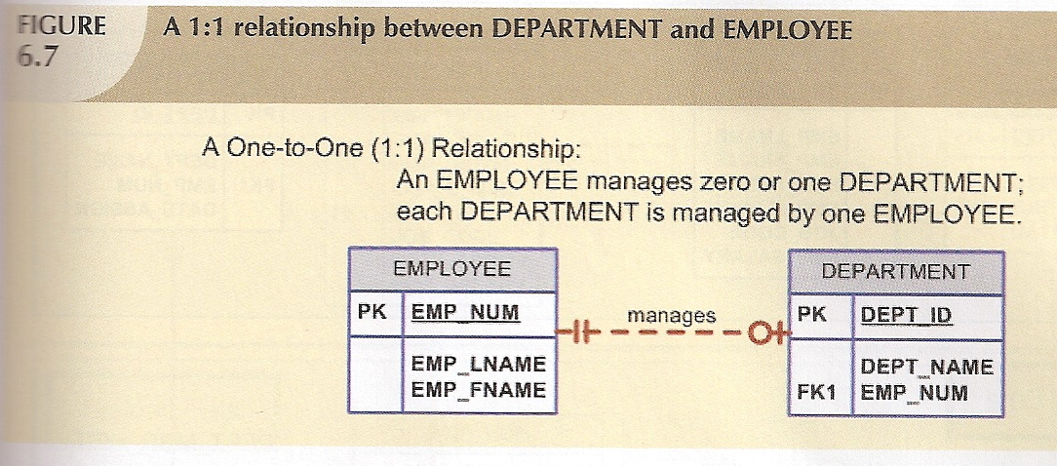
Modeling 1:1 Relationship

Slide 27
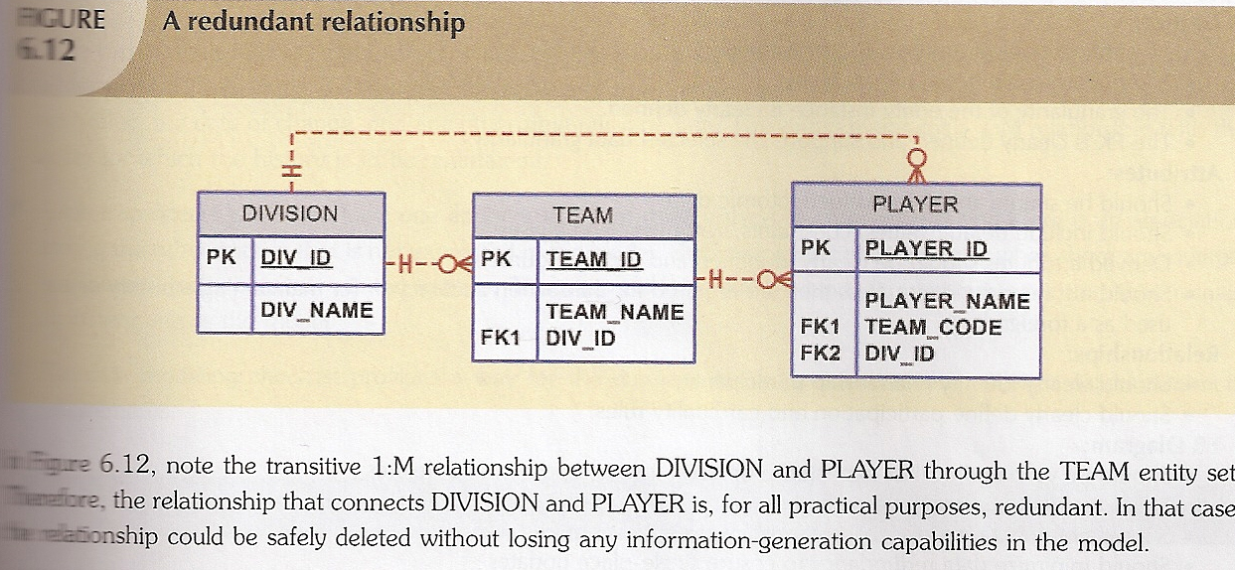
Redundant Relationship

Slide 28
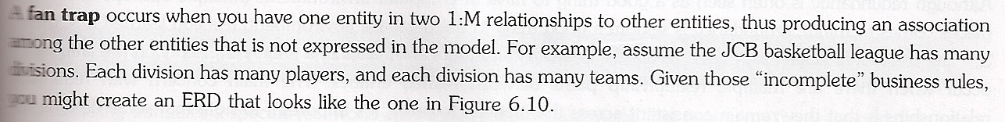
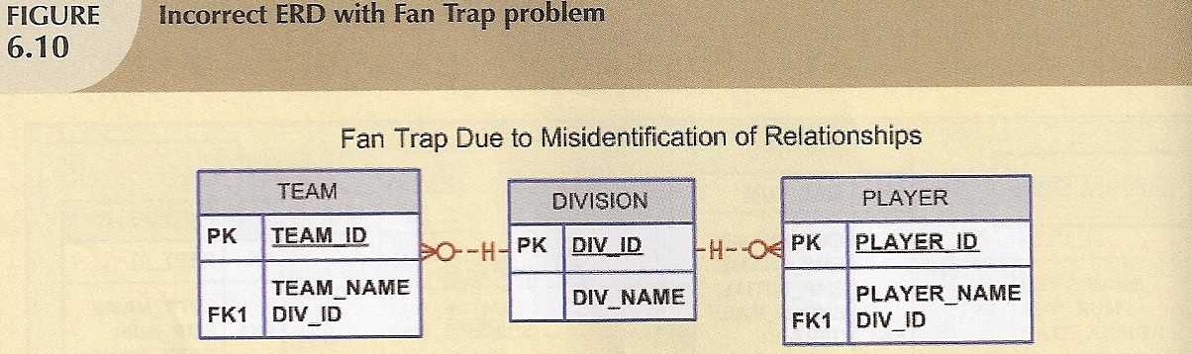
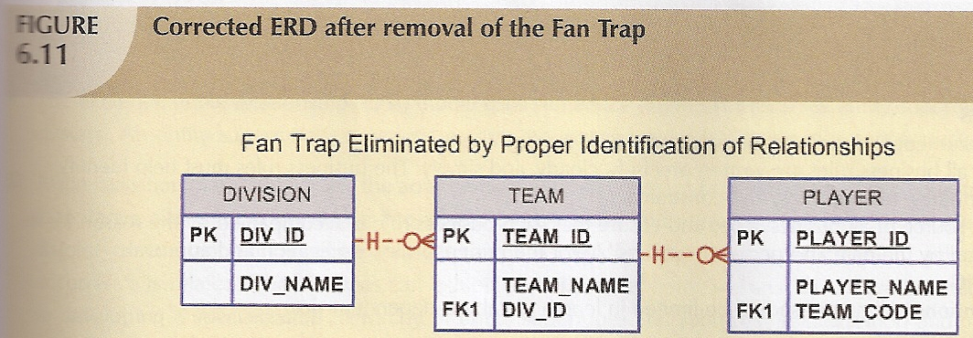
Fan Trap Problem

Slide 29
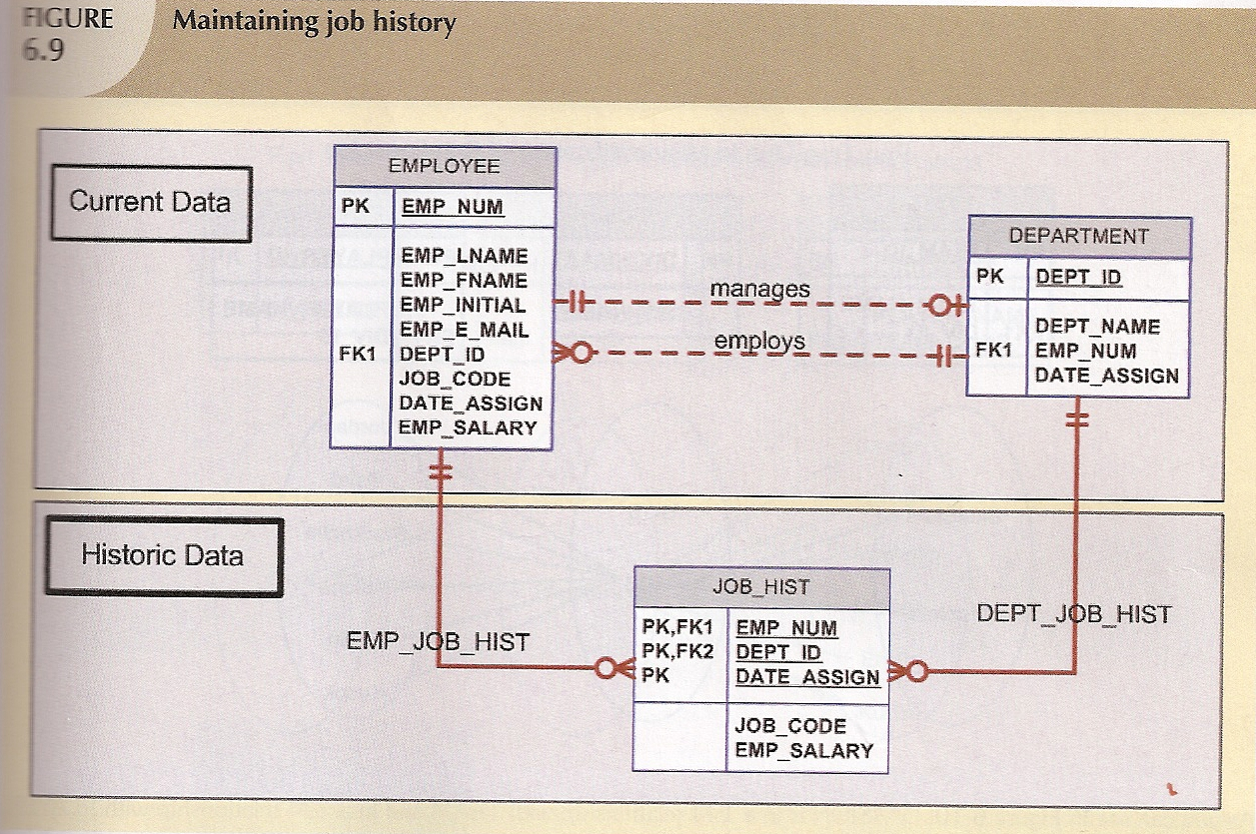
Recording History

Slide 30
Attribute: Domain
The set of acceptable values that is associated with a particular Attribute. This is sometimes referred to as the Value Set
A Domain may be associated with more than one Attribute but each Attribute is associated with a single Domain.
A Domain may be ORDERED or UNORDERED.
An UNORDERED domain does not permit the use of the following comparators: >, ≥, <, ≤.
Domains are not displayed in ER diagrams.

Slide 31
Attributes: Atomic vs. Composite
Atomic (or Simple)
Cannot be subdivided
Age, Gender, Marital Status
Composite
Can be subdivided into additional attributes
Address into Street, City, Zip
Phone into Area Code , Number, & Extension

Slide 32
Attributes: Composite
can be divided into smaller subparts.

Slide 33
Attributes: Single-Valued vs Multi-Valued
Single-Valued:
Each Entity or Relationship instance can have only a single value for the given Attribute at any moment of time.
Person has one Gender, one DOB, …
Multi-Valued:
Each Entity or Relationship instance can have multiple values for the Attribute at any moment of time
Person may have several college Degrees, several Phone Numbers..
Pure Relational DBMS can’t implement Multi-Valued Attributes

Slide 34
Multi-Valued Attributes: Modeling
Although the conceptual model can handle Multi-Valued Attributes, you should not implement them in the relational DBMS
Two possible solutions:
Within original the Entity type, create several new attributes
Create a new Entity type that is composed of the original Multi-Valued Attribute’s components

Slide 35
Multi-Valued Attributes: Modeling - Example

Slide 36
MultiValued Attribute: Create New Attributes
Create several new attributes, one for each of the original Multi-Valued attribute’s components
Car color converted to top color, trim color, ...etc.
Can lead to major structural problems in the table
Waste of memory; If one entity has values for all the attributes while others don’t

Slide 37
MultiValued Attribute: Create New Entity Type
A better solution: separate the Color to be in an Entity by itself
The new Entity is composed of original Multi-Valued attribute’s components
Example: The designer can now allow different colors for different car parts

Slide 38
Derived Attribute
Attribute whose value may be calculated (derived) from other attributes
Need not be physically stored within the database
Can be derived by using an algorithm (or formula)
Example: Employee AGE can be derived from DOB

Slide 39
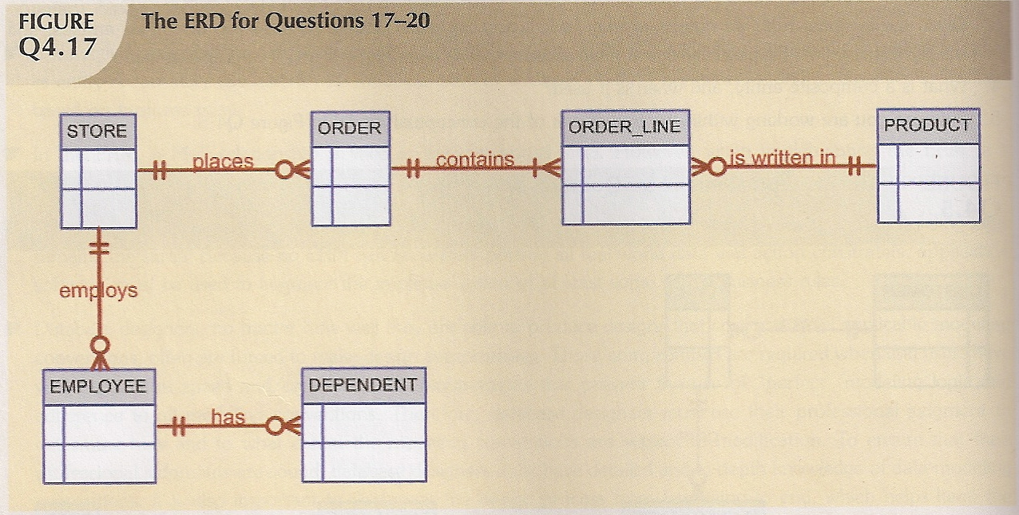
Commonly Occurring ERD

Slide 40
Extended ER (EER) Model
ER model in its original form did not support SPECIALIZATION/ GENERALIZATION Abstractions
Enhanced ER model Includes all modeling concepts of basic ER
Additional concepts: Specialization/Generalization, Subypes/SuperTypes, Subclasses/Superclasses, Attribute Inheritance, Categories
The resulting model is called the enhanced-ER or Extended ER (E2R or EER) model
It is used to model applications more completely and accurately.
Includes some object-oriented concepts, such as inheritance

Slide 41
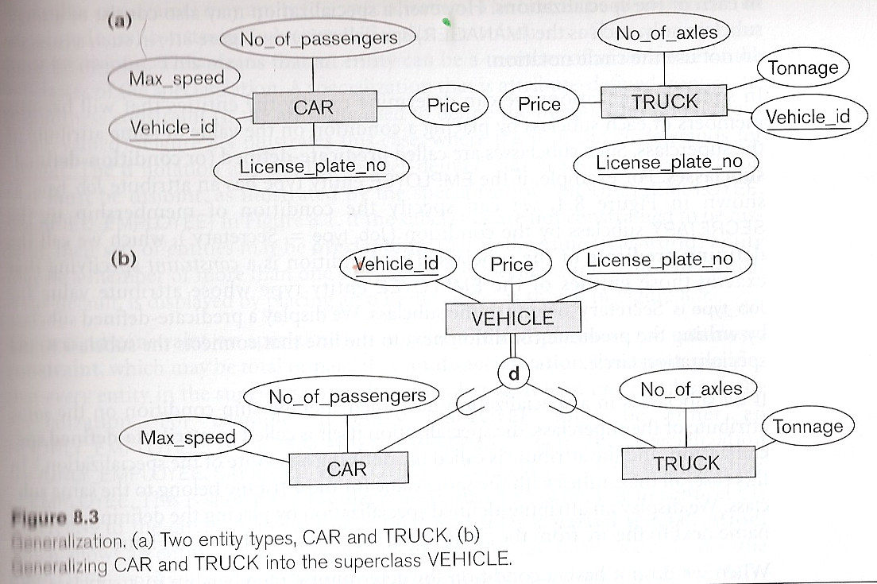
GENERALIZATION
Several entity types with common features are Generalized into a Supertype, original entity types become its Subtypes
Example: CAR, TRUCK may be generalized into VEHICLE; both CAR, TRUCK become Subclasses of the Superclass VEHICLE.
We can view {CAR, TRUCK} as a specialization of VEHICLE
Alternatively, we can view VEHICLE as a generalization of CAR and TRUCK
Specialization is the reverse of Generalization

Slide 42
Specialization & Generalization: Subtype and Supertype
An Entity that is member of a Subtype represents the same real-world Entity as some member of the Supertype
The Subtype member is the same Entity in a distinct specific role
An Entity cannot exist in the database merely by being a member of a Subtype, it must also be a member of the Supertype
A member of the Supertype can be optionally included as a member of any number of its Subtypes
Example: A Salaried Employee who is also an Engineer belongs to the two Subtypes ENGINEER and SALARIED_EMPLOYEE
It is not necessary that every Entity in a Supertype be a member of some Subtype
Do not create a Subtype/Supertype Hierarchy unless there exist at least one specific Attribute or Relationship for each Subtype entity

Slide 43
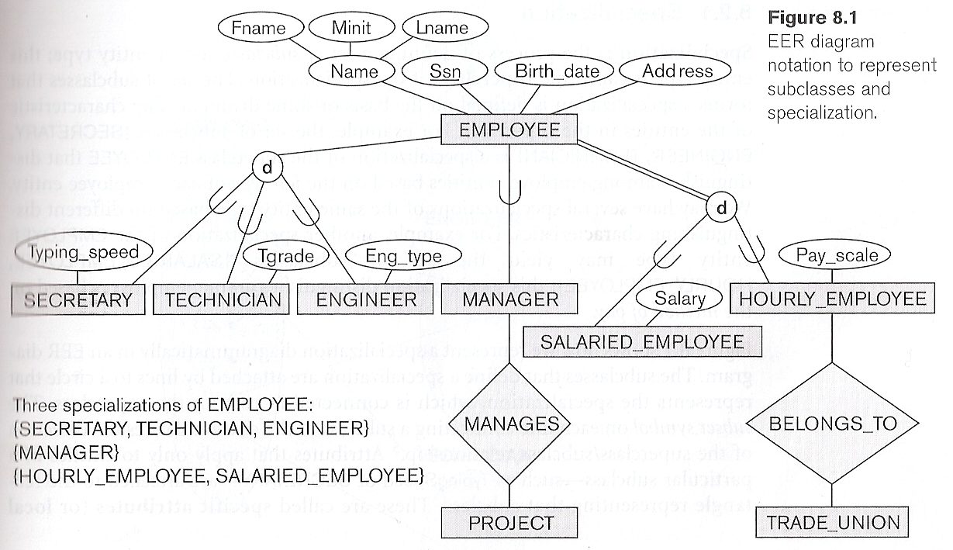
Specialization & Generalization: Example
The set of Subtypes is based upon some distinguishing characteristics of the entities in the Supertype
Example: {SECRETARY, ENGINEER, TECHNICIAN} is a specialization of EMPLOYEE based upon Job Type.
Attributes of a Subtype are called Specific Attributes.
TypingSpeed of SECRETARY
There may be several specializations of the same Supertype
Example: Another specialization of EMPLOYEE based in method of pay is {SALARIED_EMPLOYEE, HOURLY_EMPLOYEE, COMMISSION_EMPLOYEE}.
The Subtype can participate in specific Relationship types that do not apply to the Supertype.
BELONGS_TO of HOURLY_EMPLOYEE

Slide 44
Constraints on Specialization & Generalization
Generalization
the process of defining a generalized SuperType Entity from a set of Entity Types
The resulting SuperType entity must have a Discriminator attribute that indicates which of the relevant SubType(s) apply to each instance
Specialization
the process of defining a set of more specialized SubTypes of an Entity Type
Predicate/Condition defined
determine the Entities that will become members of each SubType by a condition on an Attribute value.
All member instances of the SubType must satisfy the predicate.
User defined

Slide 45
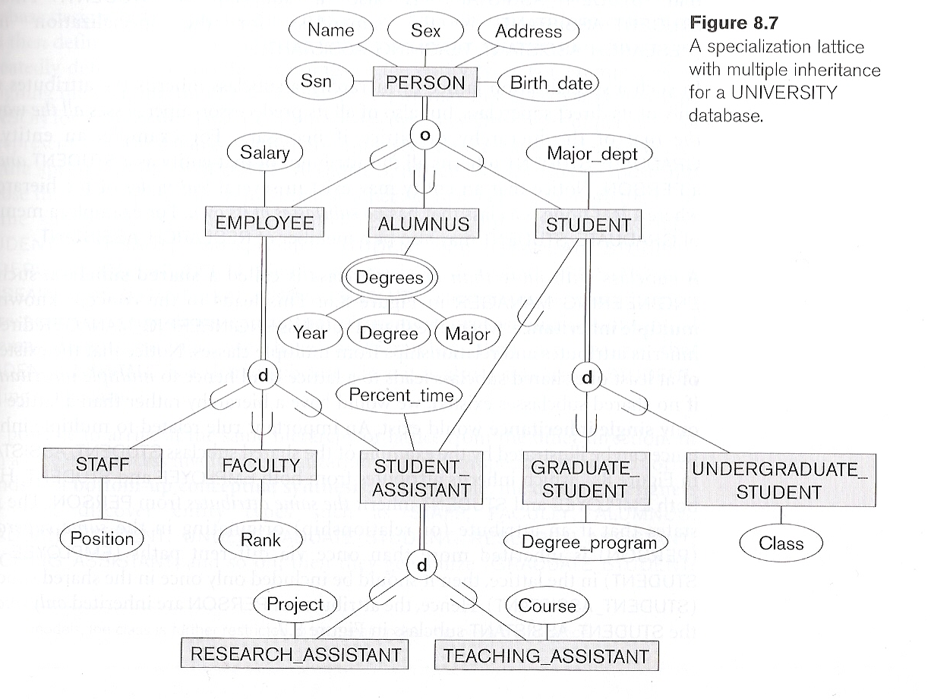
Specialization Lattice: Example

Slide 46
Constraints on Specialization & Generalization
Disjointness
Overlap (o):
the same entity instance may be a member of more than one SubClass of the specialization
Disjoint (d):
the same entity instance may be a member of only one SubClass of the specialization
Completeness
Total:
every entity instance in the SuperClass must be a member of some SubClass in the specialization.
Double Lines used as Notational Representation
Partial:
an entity instance in the SuperClass need not be a member of any SubClass in the specialization
Single Line used as Notational Representation

Slide 47
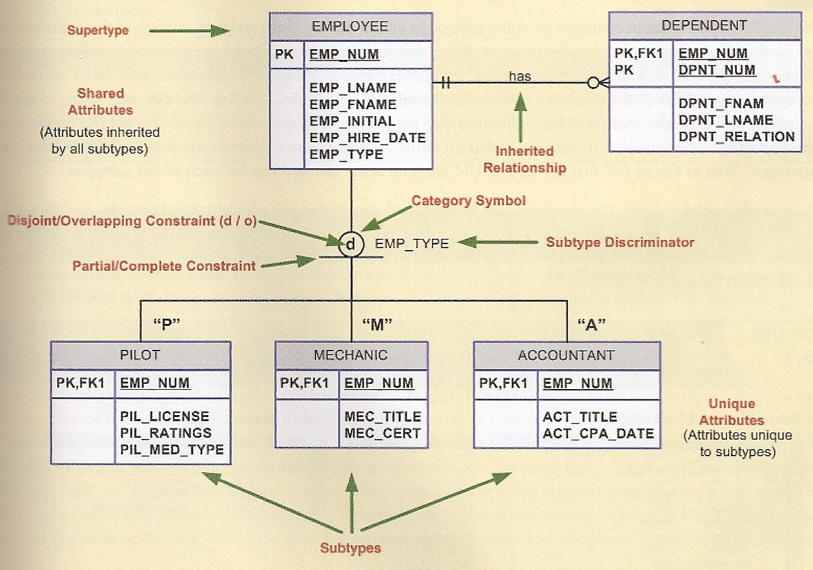
Specialization Hierarchy: Example of Disjoint (d) Subtypes

Slide 48
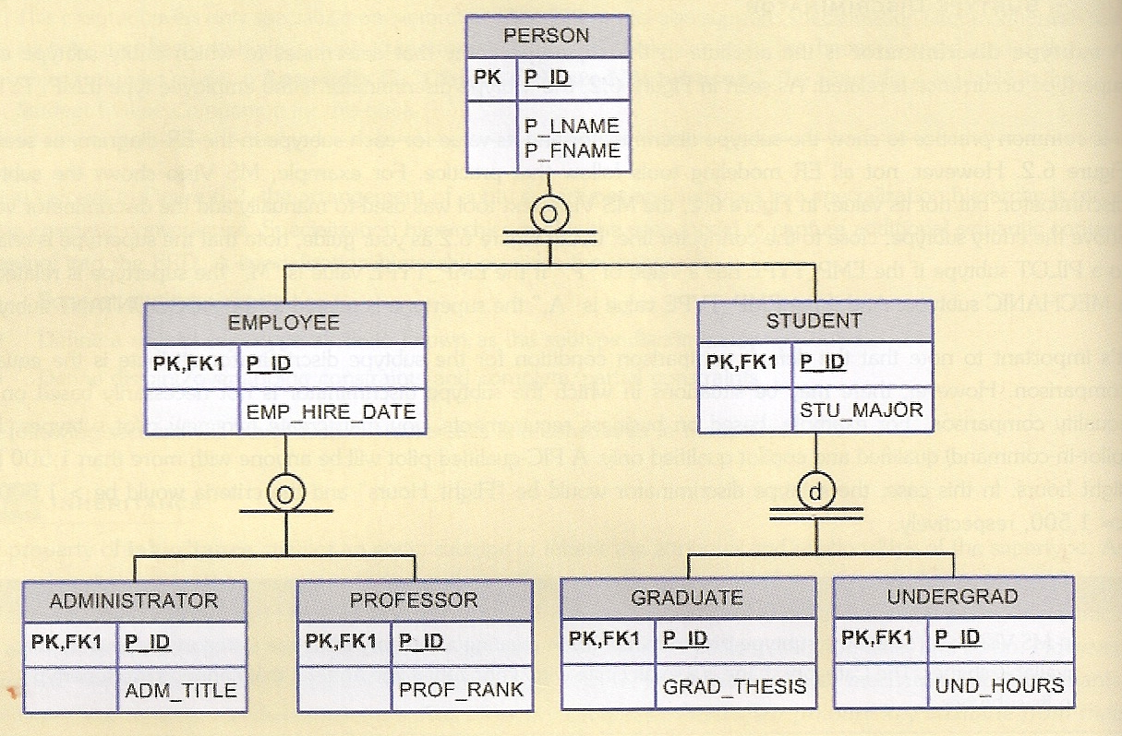
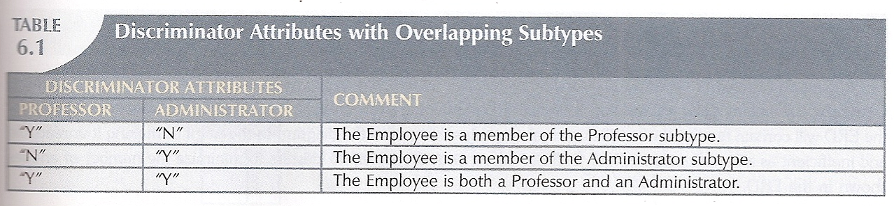
Specialization Hierarchy: Examples of Overlapping (o) Subtypes

Slide 49
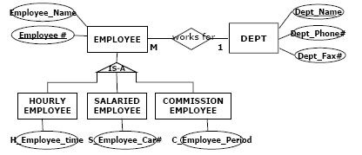
Specialization & Generalization: Attribute Inheritance
An entity that is member of a SubType INHERITS all Attributes of its SuperType entity since it is a member of the SuperType
It also inherits all Relationships

Slide 50
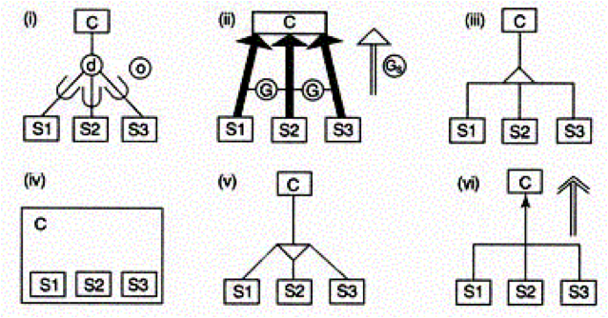
Specialization & Generalization: Some Notations

Slide 51
Categories
A Category is a SubClass of the UNION (∪) of two or more SuperClasses that can have different Identifiers because they can be of different Entity Types
If the associated SuperClasses have different Identifiers, specify a new Surrogate Identifier

Slide 52
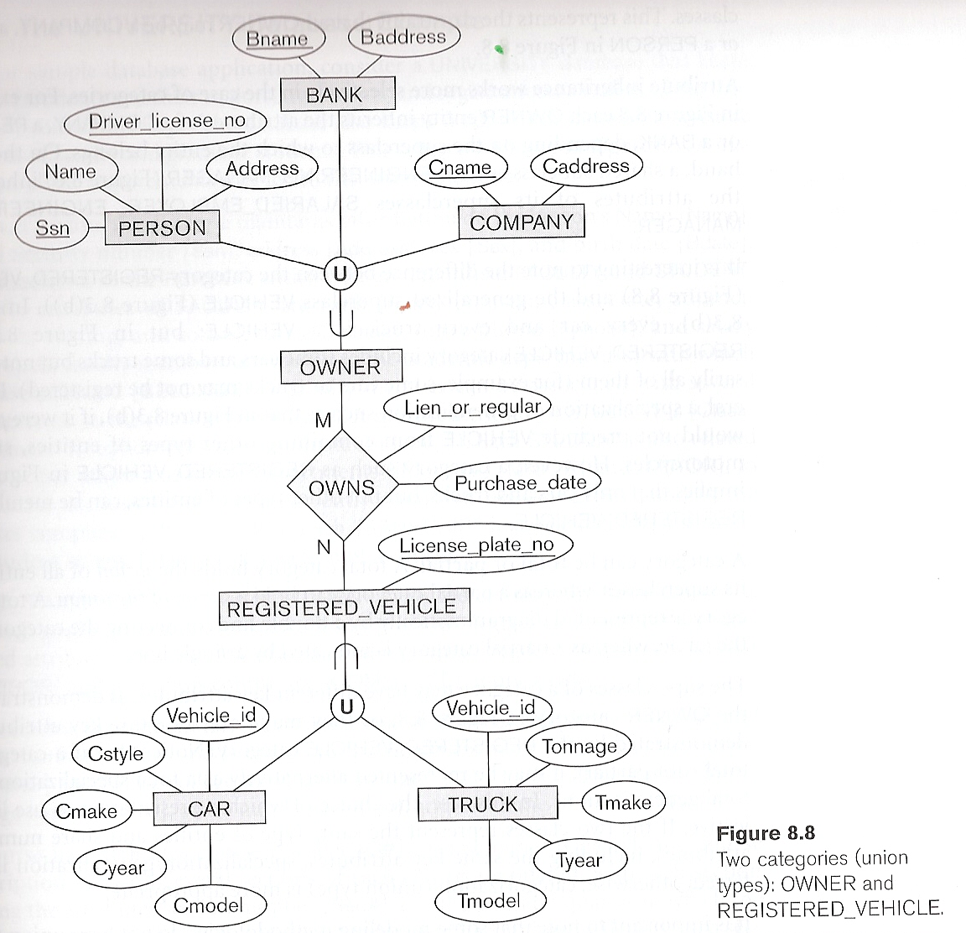
Category: Example
OWNER is a Category.
An OWNER is either a PERSON, a BANK, or a COMPANY

Slide 53
ERM Issues
Constraints play an important role in determining the best database design for an enterprise.
Several kinds of Integrity constraints can be expressed in the ER model such as Key Constraints, Participation Constraints, and Overlap/Covering Constraints for Specialization hierarchies.
Overlap constraints: Can Kofi be an Hourly_Emps as well as a Contract_Emps entity? (Allowed/Disallowed)
Covering constraints: Does every Employees entity also have to be an Hourly_Emps or a Contract_Emps entity? (Yes/No)
Some Foreign Key constraints are also implicit in the definition of a relationship set.
Some constraints (e.g. Functional Dependencies) cannot be expressed in the ER model.

Slide 54
ERM Issues
ER design is partially subjective. There are often many ways to model a given scenario! Analyzing alternatives can be tricky, especially for a large enterprise.
Common choices include:
Entity vs. Attribute
Entity vs. Relationship,
Binary or N-ary Relationship
Whether or not to use ISA hierarchies
Whether or not to use Aggregation.

Slide 55
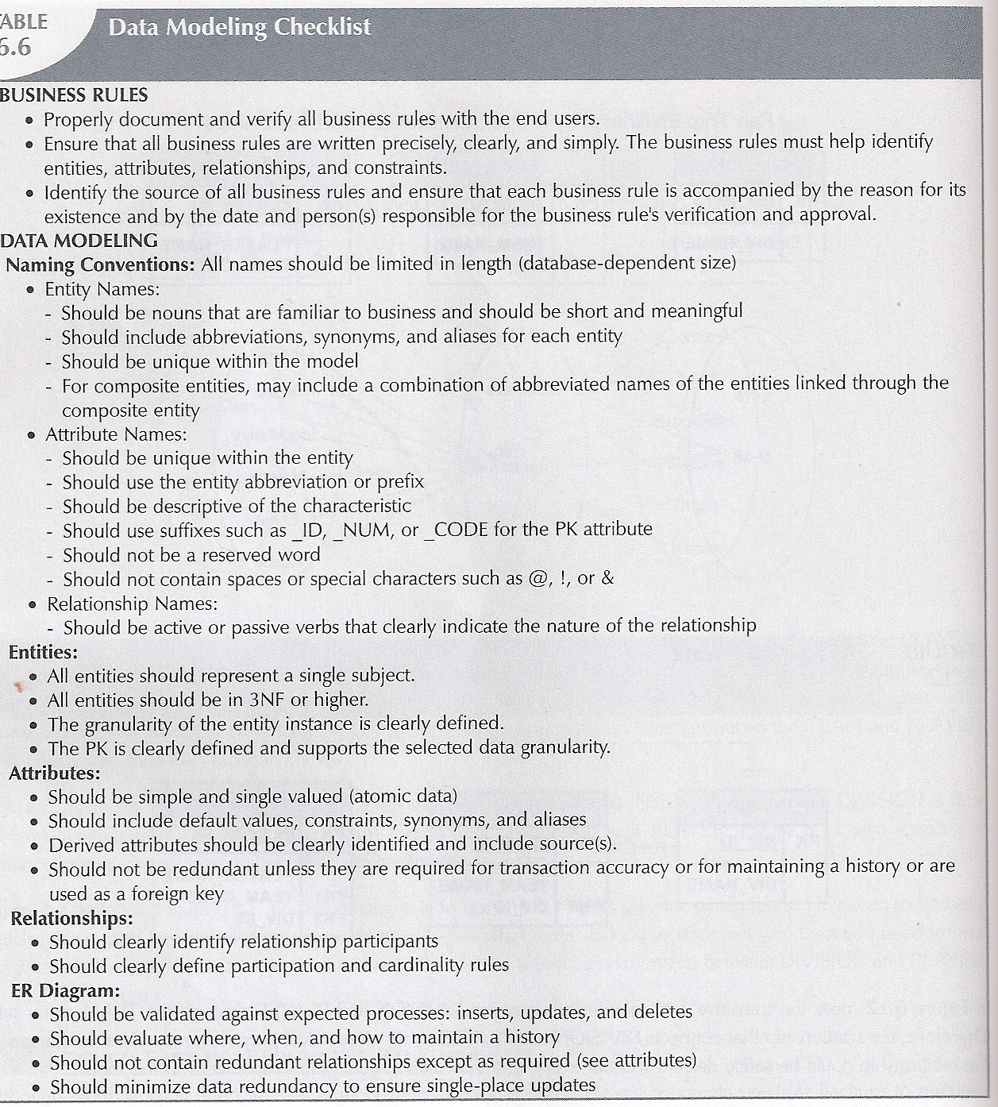

Slide 56
In-Class Exercise #2
Each School is composed of several Departments. The smallest number of Departments operated by a School is one. Each Department belongs to a single School.
Each Department offers zero or more Courses. Each Course must belong to a specific Department.
A Class is a section of a Course offered in a given semester. Each Course may have several Classes (sections). A Course may have never been offered but exist in the college catalog
Each Department has many Professors, with one of the Professors being the chair of the Department. At any point in time only one Professor can be the Department chair. No Professor is required to accept the chair position.
Each Professor may teach up to 4 Classes. Each Class is taught by a Professor at a given time in a given place. A Professor may be on research contract, or sabbatical. In which case he will not be assigned to teach any Class.
A Student may enroll in several Classes. A Class can be taken once during current enrollment period. A Class can exist even before Students are enrolled.
A Department has multiple Students. Multiple Majors are offered by a Department. A Student can have only a single Major. A Student is associated with a single Department. It is possible that a Student doesn’t have a Major. Each Student has a professor advisor. A Professor advises many Students. Not every Professor acts as an advisor.

